Slide 1

Modeling Performance of BLAST on the Betsy HPC Clusters
Trinity Cheng^{1,2}
Mentor: Mike Mikailov², PhD
¹River Hill High School, ²Office of Science and Engineering Labs, Center for Devices and Radiological Health, US Food and Drug Administration, 10903 New Hampshire Ave., Silver Spring, MD, 20993, USA
Notes:
Hello, my name is Trinity Cheng; I am a rising senior at River Hill High School. This summer, I interned with Dr. Mikailov to work on the performance evaluation of HPC applications. Today I will be talking about modeling the performance of the BLAST bioinformatics application on HPC clusters.

Slide 2
Outline
BLAST
Bioinformatics application
Problem
Reduce runtime by dividing input data on HPC
Method
Profiling and modeling
Results
Data collected on Betsy
Conclusion
Notes:
BLAST is a bioinformatics application. The goal of this project was to reduce the runtime of BLAST by dividing the input data among computing nodes on an HPC cluster. The BLAST performance was studied by profiling and modeling techniques. In this presentation, results collected from the Betsy HPC cluster are presented. These results may help improve performance for BLAST users.

Slide 3
BLAST
Software package developed by NIH/NCBI for comparing biological sequences
One of the most widely used bioinformatics applications
Original publication cited more than 94k times
Identifies matches between two user inputs:
(a) Database and (b) Query
Usually millions of sequences, files can be 100+ GB
Huge database and query make BLAST suitable for data parallelization
Mikailov et al reduced runtime from >27 days to <1 day [2017]
Parallelization of BLAST on HPC is an important research area
Notes:
Biological sequences such as DNA or amino acids. BLAST is one of the most widely used bioinformatics applications, with the original publication
[add slide about problem formulation]
[slide about three levels of profiling]

Slide 4
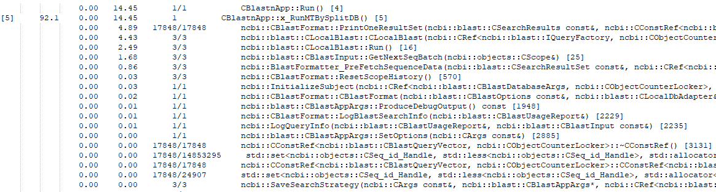
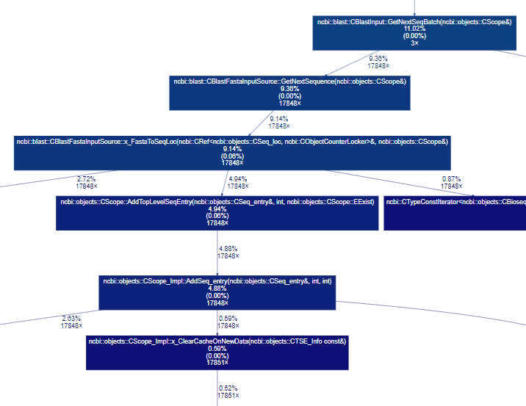
Profiling by gprof
“gprof”
Standard UNIX profiling tool
Measures runtime and call graph of all functions
Need to be compiled with “-pg” option
Executable generates “gmon.out”
gprof generates call graph in text
“gprof2dot” converts the call graph into a mathematical graph
“graphviz” renders the graph as an image
gprof text output
gprof provides runtime and call count for each function
Very slow execution, huge output data to analyze
Call graph
Notes:
Gprof is a standard UNIX profiling tool.
It measures the runtime and collects the caller-callee relationship of all functions as a call graph.
To use gprof, the application needs to be compiled with the P-G option.
The recompiled executable will generate the results in the “gmon.out” file.
The “gprof” program will generate the call graph in text as shown here.
Then we used “gprof2dot” to convert the call graph into a math graph.
Then we used “graphviz” to render the math graph as a SVG image as shown here.

Slide 5
Experiments
6 different node types on Betsy
bc011, bc017, bc111, bc124, bc165, and bc197
6 different database sizes
8179, 16358, 32716, 65432, 130862, and 261725 sequences
15 different query sizes
17848, 35695, 53555, 71389, 89258, 107188, 124961, 142778, 285555, 393022, 480935, 571110, 696210, 821372, and 1142220 sequences
Data collection
3 days to run 6x15 datapoints
> 200k lines per gprof output
Notes:
In our experiment, BLAST was run with six different nodes on Betsy, six different database sizes, and 15 different query sizes. It took around three days to run the 90 database-query combinations using the profiled version of BLAST. There were more than 200 thousand lines per gprof output generated.

Slide 6
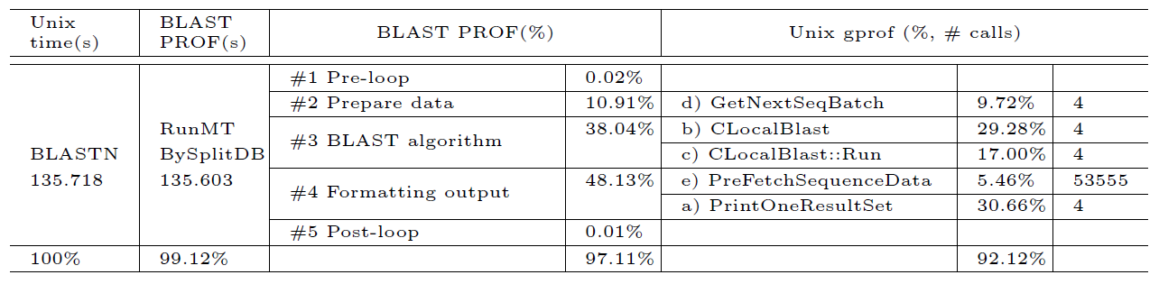
Profiling Results
gprof call-graph contains more than 34,000 functions
One parent function takes 99.12% of total runtime
Five of 53 child functions take 92.12% of total runtime
5 functions of interest were chosen to analyze and model
Notes:
By analyzing the call graph generated by gprof, we found BLAST calls 34,500 functions. One function, RunMTBySplitDB, takes 99.12% of the total runtime. This function calls 53 child functions, of which child functions which make up 92.12% of the total runtime. We decided to analyze and model these five functions of interest.

Slide 7
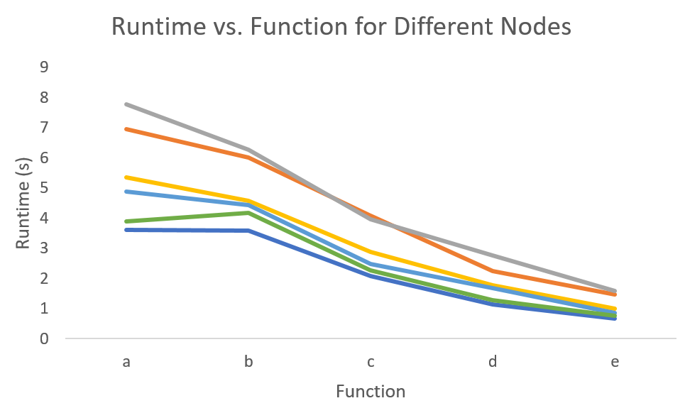
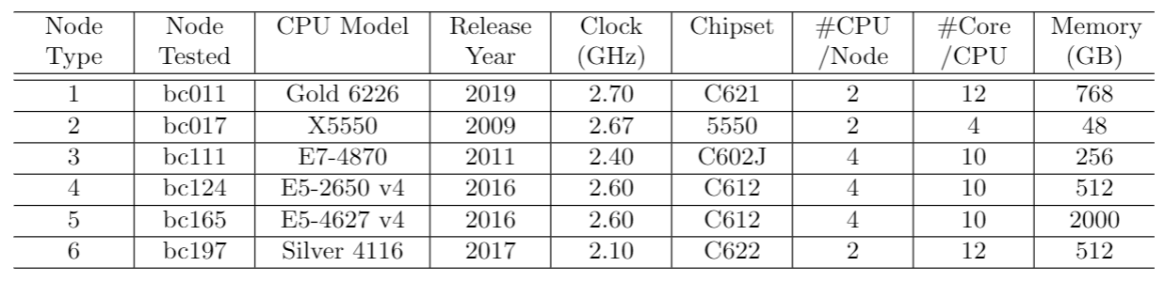
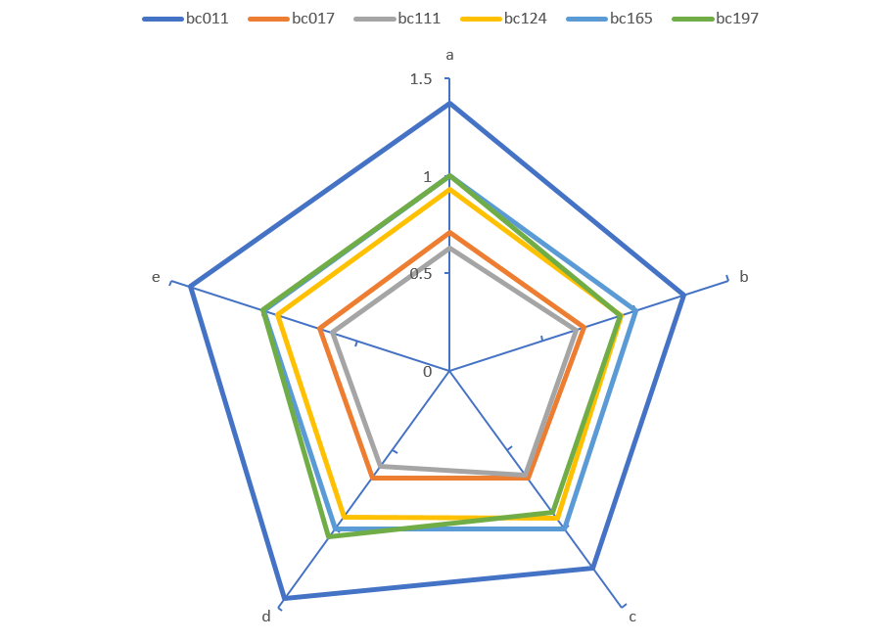
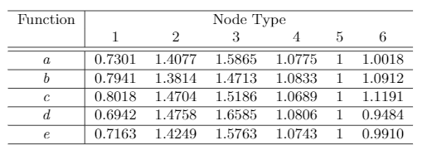
Impact of Node Performance
Experiments conducted on 6 different nodes
Normalized runtime for 5 functions of interest
Per-function performance varies
Slowest node has <50% performance of fastest node (bc111 vs bc011)
Cannot be predicted by specifications or age (bc111 vs bc017)
Notes:
The experiments were conducted on six different node types, with hardware specifications as shown in this table below.
This figure shows the runtime for the 6 nodes for 5 functions of interest. You can see that the per-function performance varies among nodes. This table shows each node’s per-function normalized to node type 5. For better visualization, the inverse of runtime, or performance, is plotted as a radar chart.
[add pie chart, stacked bar charts, explain db/query influence]
We found that the per-function runtime varies among the different nodes – the slowest node (bc111 or node type 3) can run more than 50% slower than the fastest node. The performance of the nodes cannot be predicted with just hardware specs.

Slide 8
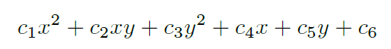
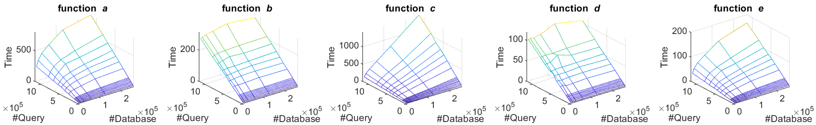
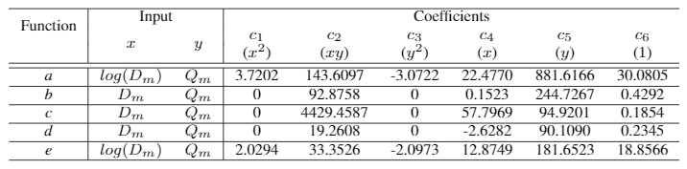
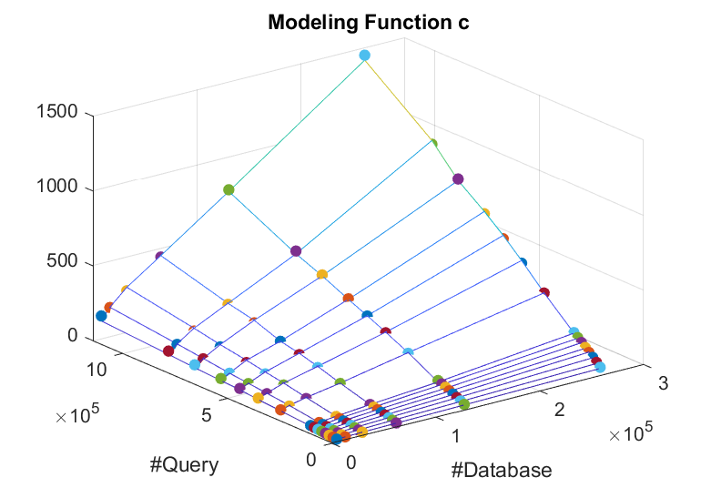
Modeling Runtime
a and e modeled with a saddle, which descends faster in the #query dimension
b and d modeled with a plane, proportional to #query only
c modeled with a plane, proportional to #database and #query
Notes:
The runtime vs. database and query size was plotted as a surface for each function.
We noticed that functions a and e are saddle-like, while functions b,c,d are like planes.
We used this quadratic equation to fit each surface with Matlab. The coefficients are shown in this table.
Notice the values in red boxes indicate that the influence of query size is much greater than database size.
Also notice the zero entries in the table indicate a saddle surface degenerated into a plane.
On the right-hand side is an example of the fitting.
[split into two slides]

Slide 9
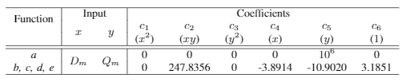
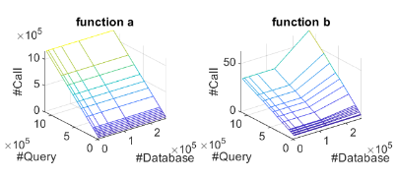
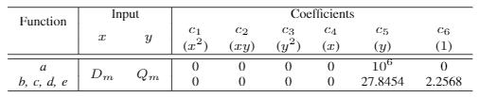
Modeling Call Count
Function runtime is dependent on number of times it is called
Used gprof to get call count for 5 functions of interest
Function a called many more times, depends only on #query
Functions b, c, d, and e have the same call count, which can be modeled by two planes (take greater of two functions)
call count for function a depends only on the number of query sequences
call count for functions b, c, d, and e (part B) also only depends on number of query sequences

Slide 10
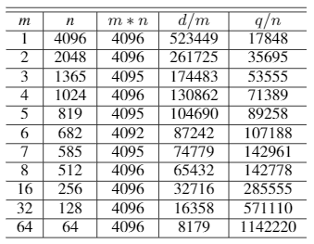
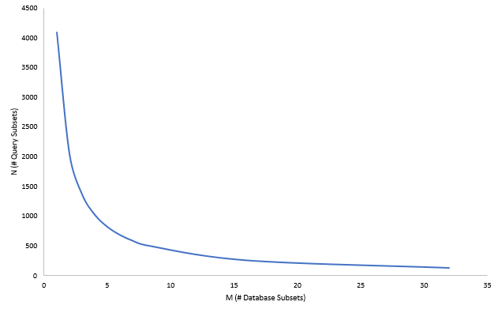
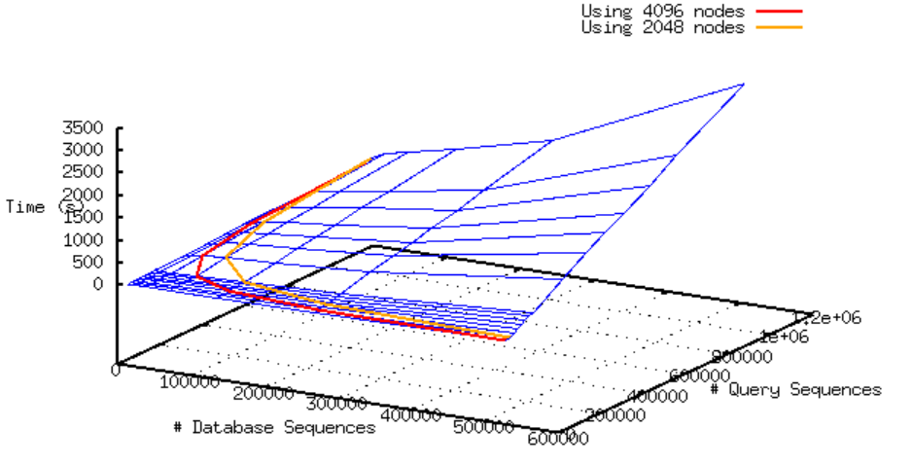
Optimization – Homogeneous Cluster
Assuming fixed database (D), fixed query (Q), and fixed number of identical nodes (P):
Database and query can be divided into subsets of size D/m and Q/n to be processed on m*n=P nodes
Red contour represents the different m and n combinations when P=4,096
Optimal division when P=4,096, d=523,449, and q=73,102,023 is (m,n)=(2,2048)
dividing query is more effective than dividing database in reducing runtime
optimal division on node type 5 is 5.4x faster than when database and query are divided evenly

Slide 11
Optimization – Heterogeneous
Instead of identical nodes, consider a cluster with 50% type 2 nodes and 50% type 5 nodes
User has to wait for the longest job, so runtimes of two nodes should be equal
More data should be allocated to type 5 nodes, which are around 1.54x faster
Models determined that 63.58% of data should be allocated to type 5 nodes
New data partitioning resulted in runtime of 46.97 seconds, 20% faster than when data was divided evenly
amount of data portioned is not proportional to time decrease, so models are necessary
optimal division of data is 20% faster than when data is split evenly among two different nodes
Notes:
[add data from four test cases]

Slide 12
Conclusion
In BLAST, five of 34k functions cover 92% of the runtime
Models were developed to estimate runtime of the 5 critical functions
Reducing query is more effective than reducing database
Profiler “gprof” can be used to identify critical functions of an application
Modeling node performance differences helps with load balancing in HPC clusters
Faster nodes should be allocated more data, which is not proportional to
Notes:
[modify this from discussion + conclusion]

Slide 13
Acknowledgments
The views presented in this article do not necessarily reflect the current or future opinion or policy of the U.S. Food and Drug Administration. Any mention of commercial products is for clarification and not intended as an endorsement. This project was supported in part by an appointment to the Research Participation Program at the U.S. Food and Drug Administration administered by the Oak Ridge Institute for Science and Education through an interagency agreement between the U.S. Department of Energy and the U.S. Food and Drug Administration. The authors thank Dr. Kenny Cha, Dr. Arifa Khan, and the CDRH HPC team for their guidance and advice.

